Slide 1
The HelpichaIr
Dawson Green
Tony Muilenburg
Luis Santiago

Slide 2
Previous Work
Rhino Arm Wheelchair
The Helpichair was initially based upon a design that used a Rhino Robotics XR-3 Rhino Robotic Arm to assist a wheelchair bound individual with manipulating the environment around them.
Previous Design has many well Documented Problems

Slide 3
Hardware Implementation
4 Degrees of Freedom of Motion
Spoon Position Set by Cartesian Arm
Built mostly from reused parts
OpenCV powered Position Analysis
Provides data for tracking where spoon is during eating process
1 camera (horizontal-vertical axes) implemented at this time

Slide 4
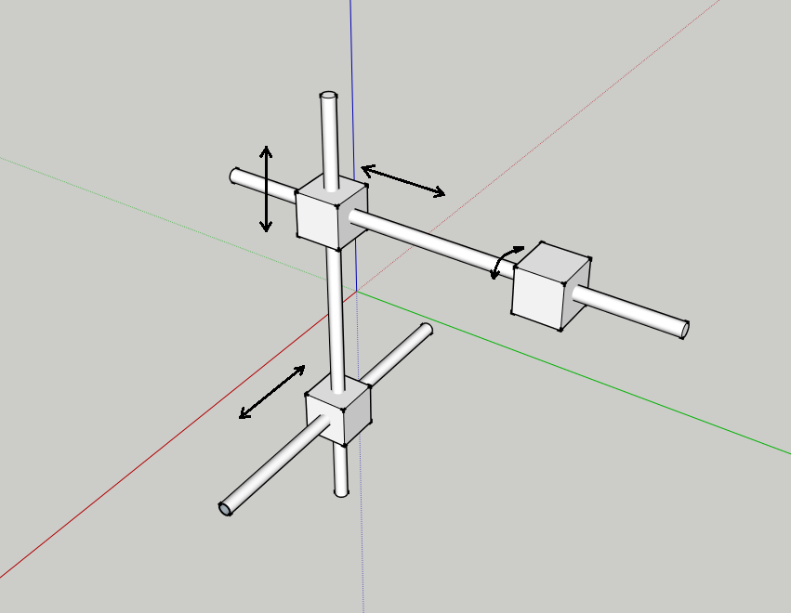
Kinematics
$$\text{τ}\text{=}\text{M}\text{∗} \text{g}\text{∗}\text{r}$$
Values
r_{x}=19mm
r_{y}=13mm
r_{z}=3.18mm
Mass = 2.26kg
G= 9.81
Arm Weight: 5 pounds or 2.26Kg
X-axis Torque: 0.436 Nm
Y-axis Torque: 0.288 Nm
Z-axiz Torque: 0.071 Nm

Slide 5
Software Design
Vision
Open CV
Code
Motor Control Code
Stepper Motor Controller
Arduino
Motor for Z axis
Servo X axis
Servo Y axis
Servo for spoon control

Slide 6
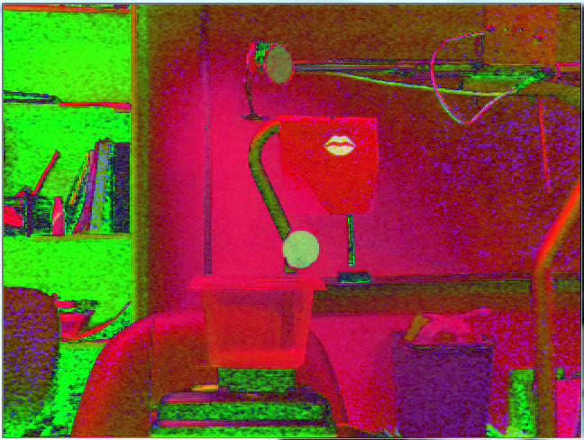
OpenCV Vision
Capture image from camera
Use HSV, erode, dilate filters and then some centroid functions.
After image filtered subtract distance on pixels
Pass the results to control program convert into instructions to the motors

Slide 7
Software
User interface framework coded in Visual Studio C++
Reads position data from output of OpenCV program
Establishes connection with motors
Performs basic diagnostics, permits manual control and maintains algorithm for patient feeding process
OpenCV position data is translated into motor rotational speeds via fuzzy logic algorithm

Slide 8
Firmware (Arduino)
Interface features
Reads commands via serial port access
Controls multiple axes simultaneously
Permits repeatable spoon motion
Allows user to set servo continuous speed
Sample Firmware Code
// check serial buffer has something
if (Serial.available() > 0) {
// read first byte on serial and store it
int inByte = Serial.read();
// check if it is one the defined cases
switch (inByte) {
case 'x':
// Valid case, wait for an int and store it in pos
pos = Serial.parseInt();
// provides feedback for debuf if needed
#ifndef Silent
Serial.print("Servo X=");
Serial.println(pos);
#endif /* Silent */
xservo.write(pos);
break;

Slide 9
Firmware (Stepper Motor)
Interface features
Reads commands via serial port access
Ramps motor speed to reduce stress on system components
Provides high precision motor control
Motor can lock into position and support significant stress

Slide 10
Challenges
Weight and cost
Vision filters are very sensitive to room lighting
Arm Construction Very Time Consuming
Controlling Servo Speeds

Slide 11
Demo

Slide 12
Future Work
Automate Helpichair motion using vision
Built a Stronger arm
Make arm rotate
Electric Circuit to operate permanently of batteries
Utilize a genetic algorithm to optimize Helpiarm motions

Slide 13
Resources
Code, videos, Data Sheets and Development Documents available at
http://smartwheelchair.themuilenburgs.com
Visual Studio can be obtained from Dreamspark website via CAT: click here
(if link is broken just go to CAT website and type Microsoft in search)
Arduino IDE and instructions can be found at Arduino website
http://arduino.cc/en/Main/Software

Slide 14
Questions

